Slide 1

Data Scientist Job Change Prediction
IT3190E - 123220
DSAI 01 K64
Team 3

Slide 2
Members & Contribution
image
Nguyễn Việt Hoàng
SID: 20194434
image
Phan Đức Thắng
SID: 20194452

Slide 3

Problem Statement
Goal: Predict if a data scientist will look for a job change and evaluate which factors affect his decision.
Use case:
A company that is hiring employee can know among the candidates which one is really looking for a new job, which reduces the cost and time of finding new employees.
Predict which employee is likely to look for a job change, and analyze which factors influent his decision.

Slide 4
Data
Feature | Type, domain | Description
enrollee_id | int64 [ 8949, 29725, 11561, ...,] | Unique ID for candidate.
city | object ['city_103', 'city_40', 'city_21', 'city_115', ...] | City code.
city_development_index | float64 [0.92 , 0.776, 0.624, 0.789, ...] | Development index of the city.
gender | object Domain: ['Male', nan, 'Female', 'Other'] | Gender of the candidate.
relevent_experience | object ['Has relevent experience', 'No relevent experience'] | Whether the candidate has relevent experience.
enrolled_university | object ['no_enrollment', 'Full time course', nan, 'Part time course'] | Type of University course the candidate enrolled.
education_level | object Domain: ['Graduate', 'Masters', 'High School', nan, 'Phd', 'Primary School'] | Education level of the candidate t.
major_discipline | object Domain: ['STEM', 'Business Degree', nan, 'Arts', 'Humanities', 'No Major', 'Other'] | Education major discipline of the candidate.
experience | object ['>20', '15', '5', '<1', '11', '13', '7', '17', '2', '16', '1', '4', '10', '14', '18', '19', '12', '3', '6', '9', '8', '20', nan] | Candidate’s total experience, measured in years.
company_size | object [nan, '50-99', '<10', '10000+', '5000-9999', '1000-4999', '10/49', '100-500', '500-999'] | Number of employees in current employer's company.
company_type | object [nan, 'Pvt Ltd', 'Funded Startup', 'Early Stage Startup', 'Other', 'Public Sector', 'NGO'] | Type of current employer’s company.
last_new_job | object ['1', '>4', 'never', '4', '3', '2', nan] | Time interval between previous job and current job (in years).
training_hours | int64 [ 36, 47, 83, 52, 8, 24, 18, 46, 123, 32, ...] | Training hours completed.
2.1 Features
Each example in the dataset is a vector of 13 x 1 vector with the following features:

Slide 5
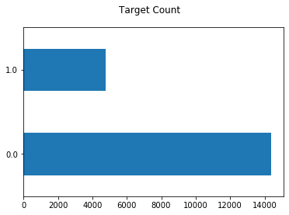
Label
An assigned label of either “yes” or “no” for the question whether the candidate is looking for a new job.
Values:
0 – The candidate is not looking for a new job.
1 – The candidate is looking for a new job.

Slide 6
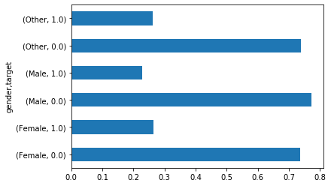
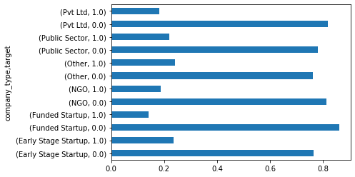
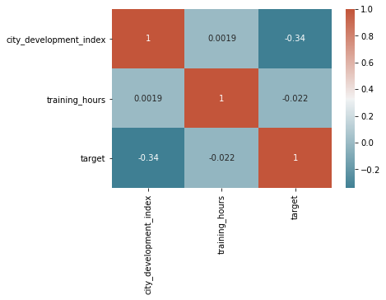
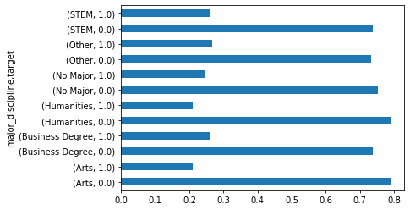
Explore
Categorical features
Numerical features

Slide 7
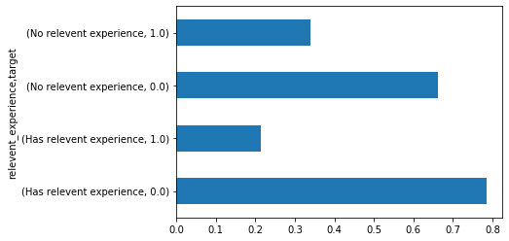
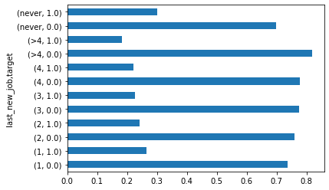
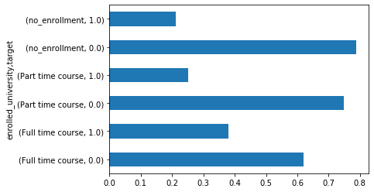
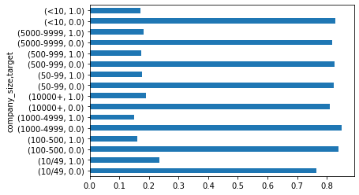
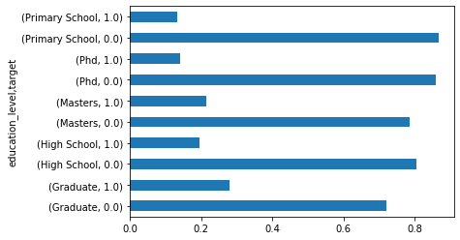
Ordinal features

Slide 8
Data Preprocessing
Standard Scaler
Train set
Fit & Transfrom
Numerical
Stratified shuffle split
Fill NaN with most frequent value
Processed output
Test set
Input set
Standard Scaler
Transform
Ordinal
Transform
Categorical
Fill NaN with most frequent value, add NaN_indicator attribute
One hot encoder
CV set
Standard Scaler

Slide 9
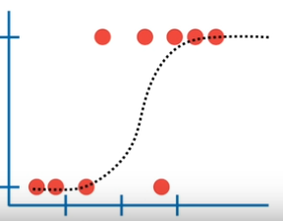
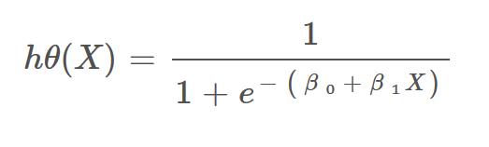
Algorithm
Logistic Regression
Logistic regression will learn the vector β = [β₀, β₁, …, β_{n}] correspond to the hypothesis function
The model will predict 1 if h(X) > threshold and 0 otherwise.

Slide 10

Cost function
In our problem we apply logistic regression for imbalanced data by using class_weight = “balanced” parameter and l2 regularization. The algorithm will then try to minimize the following cost function:
$$J=−\frac{1}{m}\sum{[w_{0}}∗log⁡(h\left(x^{\left(i\right)}\right)∗y^{\left(i\right)}+w_{1}∗\left(1−y^{\left(i\right)}\right)∗\log\left(1−h\left(x^{\left(i\right)}\right)\right]+ \frac{λ}{2m}β^{T}β$$
w0, w1 are the weight apply to class 0 and 1 respectively. To fix imbalanced data problem, the algorithm will assign the higher weight to the class with less data in the training set. In sklearn, the weight for each class when apply class_weight = “balanced” is calculated as:
n_samples / (n_classes * n_samples_with_class).
λ is the regularization coefficient, larger λ will lead to a model that is less overfitted. In scikit-learn implementation, they use a coefficient C which is proportional to the inverse of λ which has the reversed effect (larger C imply higher variance).

Slide 11
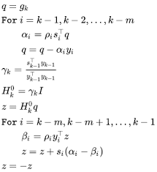
Hyper-parameters
class_weight = ‘balanced’
penalty = ‘l2’
C = 0.1
solver = ‘lbfgs’
C value | f1-score on Train set | f1-score on CV set
0.0001 | 0.5757802000895924 | 0.5901639344262296
0.001 | 0.6114649681528662 | 0.6171284634760706
0.01 | 0.6123271889400922 | 0.6185480486781368
0.1 | 0.6133256583681106 | 0.6191275167785234
1.0 | 0.6132374100719424 | 0.6188679245283019
10.0 | 0.6133256583681106 | 0.6188679245283019
100.0 | 0.6133256583681106 | 0.6188679245283019

Slide 12
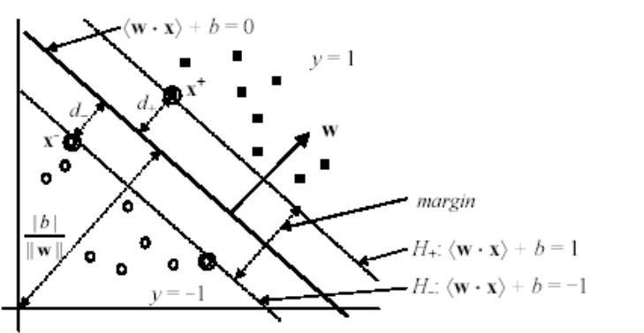
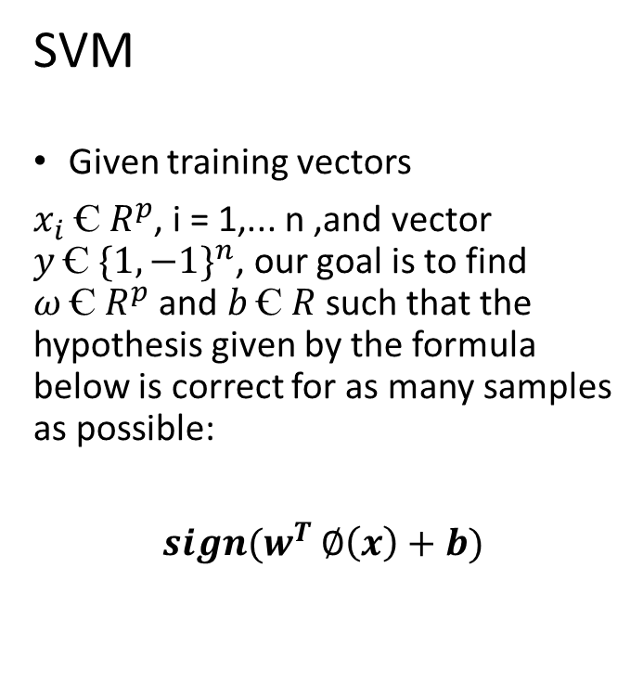

Algorithm
SVM
Given training vectors
$x_{i} Ꞓ R^{p}$, i = 1,... n ,and vector $y Ꞓ {\{1, −1\}}^{n}$, our goal is to find $ω Ꞓ R^{p}$ and $b Ꞓ R$ such that the hypothesis given by the formula below is correct for as many samples as possible:
$sign(w^{T}$ $∅\left(x\right)+b)$
Primal problem:
$$\min_{ω,b,ζ}{\frac{1}{2} ω^{T}ω+C \sum_{i=1}^{n}{ζ_{i}}}$$
subject to: $\left\{\begin{aligned}y_{i}(ω^{T}∅\left(x_{i}+b\right)≥1− ζ_{i}, \\ ζ_{i }≥0, i=1,…, n\end{aligned}\right.$

Slide 13
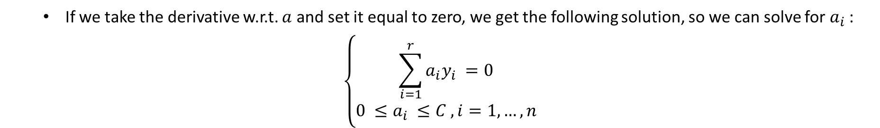
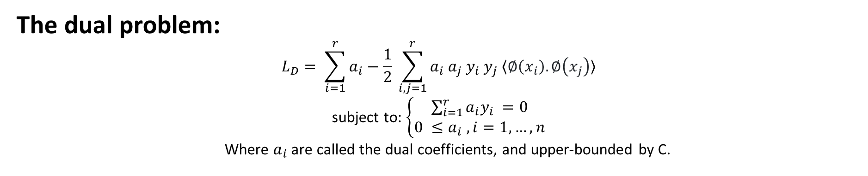
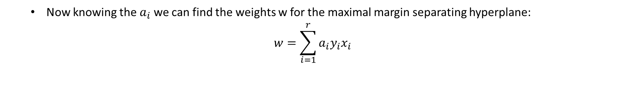
The dual problem:
$$L_{D}= \sum_{i=1}^{r}{a_{i}}−\frac{1}{2} \sum_{i, j=1}^{r}{a_{i} a_{j}{ y}_{i}{ y}_{j} 〈∅\left(x_{i}\right).∅\left(x_{j}\right)〉}$$
subject to: $\left\{\begin{aligned}\sum_{i=1}^{r}{a_{i}y_{i}} =0 \\ 0 ≤a_{i} , i=1,…, n\end{aligned}\right.$
Where $a_{i}$ are called the dual coefficients, and upper-bounded by C.
If we take the derivative w.r.t. $a$ and set it equal to zero, we get the following solution, so we can solve for $a_{i}$ :
$$\left\{\begin{aligned}\sum_{i=1}^{r}{a_{i}y_{i}} =0 \\ 0 ≤a_{i} ≤C , i=1,…, n\end{aligned}\right.$$
Now knowing the $a_{i}$ we can find the weights w for the maximal margin separating hyperplane:
$$w=\sum_{i=1}^{r}{a_{i}y_{i}x_{i}}$$

Slide 14
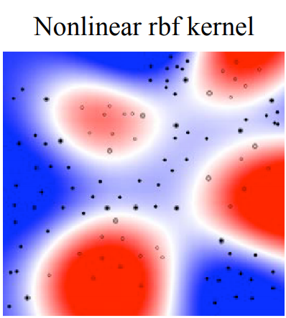

Kernel
The reason for using $∅\left(x\right)$ - a nonlinear mapping instead of x is to transform the input data space into another higher dimension space so that the transformed one is linearly separable
Since we only need the $〈∅\left(x_{i}\right).∅\left(x_{j}\right)〉$, we use kernel function K<x,z> to calculate that value the those inner-products. The kernel that we use in this project is Gaussian RBF:
$K\left(x,z\right)= e^{−\frac{{\left|\left|x−z\right|\right|}^{2}}{2σ}}$ ; where $σ>0.$

Slide 15

Hyper-parameters
kernel = ‘rbf’
C = 200
gamma = 0.0005
With C is the inverse of regularization parameter, and gamma is denoted by $σ$ in the kernel function:
$$K\left(x,z\right)= e^{−\frac{{\left|\left|x−z\right|\right|}^{2}}{2σ}}$$
 | gamma = 0.0002 | gamma = 0.0005 | gamma = 0.001
C = 100 | 0.6073040623718 | 0.60928270042194 | 0.60529743812419
C = 200 | 0.6053169734151 | 0.61030042918455 | 0.59749243406831
C = 500 | 0.6082949308756 | 0.60243055555556 | 0.59939629150496

Slide 16
Result
 |  | Logistic Regression model | SVM model
Train set | Accuracy | 0.77 | 0.80
 | Recall | 0.74 | 0.77
 | Precision | 0.52 | 0.57
 | f1 | 0.61 | 0.66
Cross Validation set | Accuracy | 0.76 | 0.76
 | Recall | 0.77 | 0.74
 | Precision | 0.52 | 0.52
 | f1 | 0.62 | 0.61
Test set | Accuracy | 0.77 | 0.78
 | Recall | 0.79 | 0.79
 | Precision | 0.53 | 0.54
 | f1 | 0.63 | 0.64

Slide 17
Discussion and Improvement
Discussion
SVM only performs slightly better than logistic regression, however the training time and time taken to predict is much longer. In conclusion, for this problem, logistic regression is preferred.
Compared to other teams’ works on kaggle.com, our models’ performances are on par with other complex models using more advanced libraries and algorithms.

Slide 18
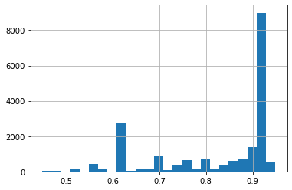
Discussion and Improvement
2. Improvement
Collect more data: When exploring data, city_development_index is an important factor to the outcome of the problem. However, with the current distribution of the data, it is impractical to perform stratified split along this attributes. In the future, if we can collect more data, we believe that the model can perform better.
Random Forest Classifier: The dataset has many categorical attributes so we hope that we can apply random forest to try to improve the result.

